Slide 1
Lecture 2
Relational Data Model & Basic SQL
INT6164 Database Systems and Management
Dr. Yang Yu
Department of Mathematics and Information Technology
The Education University of Hong Kong

Slide 2
Outline
The Relational Model: Introduction
The Relational Model: Basic SQL
Translating ER Diagrams to Tables via SQL

Slide 3
What is the Relational Model?
Relational data model, proposed by E.F. Codd in 1970’s, belongs to record-based logical models
The relational model adopts a “tabular” representation
  A database is a collection of one or more relations
  Each relation is a table with rows and columns
  Not in form of a diagram!!!
What is unique about the relational model as opposed to older data models?
  Its simple data representation
  Ease with which complex queries can be expressed

Slide 4
Basic Constructs
Relations
  Data stored as tables (called relations); each has a unique name
  A relation consists of rows (called tuples) and columns (called attributes)
Attributes
  an attribute has a name and a “domain” (a set of permitted values)
Records/instances
  A set of row/tuples
  Each row/tuple in a relation is a record (an entity)
  Each attribute in a relation corresponds to a particular field of a record/instance
Another definition of relation: Consist of
  A schema which includes the relation’s name, the name of each column, and the domain of each column
  An instance which is a set of tuples
    Each tuple has the same number of columns as the relation schema

Slide 5
DB Schema & Instance
Sample Relational DB Schema: relatively static
A corresponding DB Instance: rather dynamic
Customer
Orders
Parts
cname
C#
address
order#
C#
P#
quantity
pname
P#
cost
Customer
Parts
cname
C#
address
P#
pname
cost
John 41256 8 Blue St., LA
301 widget 25,000
Mary 56437 6 Red Ave, SF
111 gadget 17,500
Joe 23986 12 Pink Rd, NY
507 screw 5,900
Orders
order#
C#
P#
quantity
21 41256 301 15
26 41256 111 7
27 56437 301 11
32 23986 507 18
... ... ... ...

Slide 6
Definition Summary
Informal Terms Formal Terms
Table Relation
Column Attribute
Row Tuple
Values in a column Domain
Table Definition Schema
Notes:
Although languages like SQL use the informal terms of TABLE (e.g. CREATE TABLE), COLUMN (e.g. SYSCOLUMN variable), the relational database textbooks present the model and operations on it using the formal terms.

Slide 7
Characteristics of Relations
Ordering of tuples in a relation r(R): The tuples are not considered to be ordered, even though they appear in order in the table form.
Ordering of attributes in a relation schema R (and of values within each tuple): We will consider the attributes in R(A1, A2, ..., An) and the values in t=<v1, v2, ..., vn> to be ordered .
Values in a tuple: All values are considered atomic (indivisible)
  A special null value is used to represent values that are unknown or inapplicable to certain tuples.

Slide 8
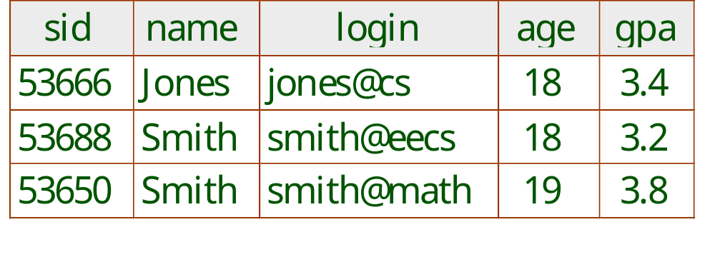
More Details on the Relational Model
Degree (or arity) = # of fields
Cardinality =
# of tuples
An instance of the “Students” relation
What is the relational database schema (not the relation schema)?
  A collection of schemas for the relations in the database
What is the instance of a relational database (not the instance
of a relation)?
  A collection of relation instances

Slide 9
ER Model vs. Relational Model
ER Model
  Conceptual or high-level models
  Focus on entities, and how they interact with each other
  Consist of entities, relationships, and attributes
  Possible to show cardinalities
  Are often converted into relational schemas to better show the data.
Relational model
  A representational or implementation model
  Focus on information, and tables with related data to make up the database
  Consist of tables, records, and domains
  Not possible to see cardinalities

Slide 10
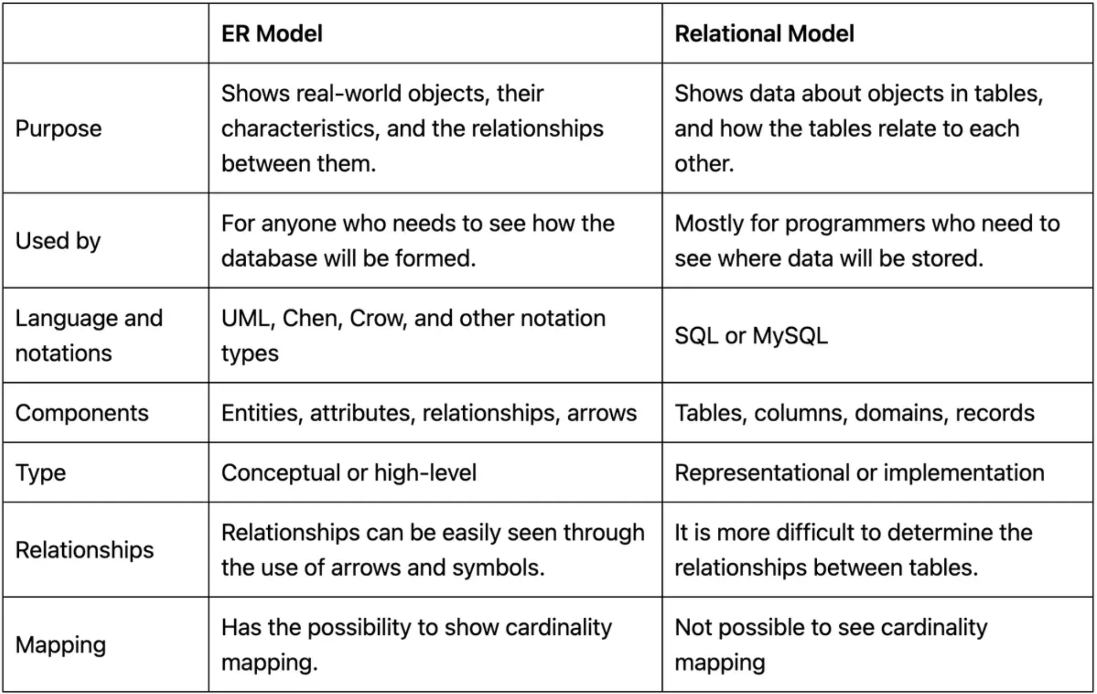
ER Model vs. Relational Model

Slide 11
Mapping ER Diagrams into Tables
Representation of (Strong) Entity Sets
E
a1
a2
ak
a1 a2 … ak
e1
xx yy … zz
...
e2
Data
(entities)
E
:
{e1, e2, …, ej}

Slide 12
Mapping ER Diagrams into Tables
Representation of weak entity
Primary key
s1
...
sr
sn
w1
...
wm
...
1
N
ES
R
EW
ES
EW
s1 … sr ... sn
s1 … sr w1 … wm

Slide 13
Mapping ER Diagrams into Tables
Representation of N:M Relationship Sets
Primary key
Primary key
s1
sr
sn
w1
wm
...
...
A
wq
...
...
Ea
M
R
N
Eb
R
s1 … sr w1 … wq A

Slide 14
Outline
The Relational Model: Introduction
The Relational Model: Basic SQL
Translating ER Diagrams to Tables via SQL

Slide 15
SQL - A Language for Relational DBs
A major strength of the relational model is that it supports simple and powerful querying of data
Structured Query Language (SQL a.k.a. “Sequel”) is the most widely used commercial relational database language
SQL was developed by IBM (system R) in the 1970s
There is a need for a standard since SQL is used by many vendors
  SQL-86
  SQL-89 (minor revision)
  SQL-92 (major revision)
  SQL-99 (major extensions)
  SQL-2003 (minor revision)
  SQL-2011
  SQL- 2016

Slide 16
DDL and DML
The SQL language has two main aspects (there are other aspects which we will discuss tomorrow)
  Data Definition Language (DDL)
    Allows creating, modifying, and deleting relations
    and views
    Allows specifying constraints
    Allows administering users, security, etc.
  Data Manipulation Language (DML)
    Allows posing queries to find tuples that satisfy criteria
    Allows adding, modifying, and removing tuples

Slide 17
Creating Relations in SQL
S1 can be used to create the “Students” relation
S2 can be used to create the “Enrolled” relation
CREATE TABLE Students
(sid: CHAR(20),
name: CHAR(20),
login: CHAR(10),
age: INTEGER,
gpa: REAL)
CREATE TABLE Enrolled
(sid: CHAR(20),
cid: CHAR(20),
grade: CHAR(2))
S2
S1
The DBMS enforces domain constraints whenever tuples are added or modified

Slide 18

The Domain Constraints
A relation schema specifies the domain of each column which entails domain constraints
A domain constraint specifies a condition by which each instance of a relation should satisfy
  The values that appear in a column must be drawn from the domain associated with that column
Who defines a domain constraint?
  DBA (Database administrator)
Who enforces a domain constraint?
  DBMS

Slide 19
Adding and Deleting Tuples
We can insert a single tuple to the “Students” relation using:
INSERT INTO Students (sid, name, login, age, gpa)
VALUES (53688, ‘Smith’, ‘smith@ee’, 18, 3.2)
We can delete all tuples from the “Students” relation which satisfy some condition (e.g., name = Smith):
DELETE
FROM Students S
WHERE S.name = ‘Smith’
Notes:
10

Slide 20
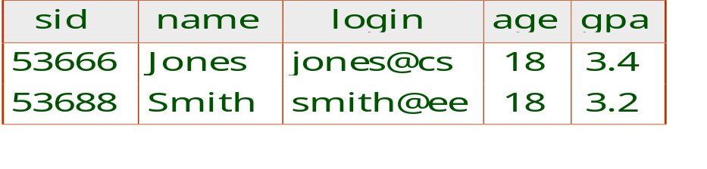
Querying a Relation
How can we find all 18-year old students?
How can we find just names and logins?
SELECT *
FROM Students S
WHERE S.age=18
SELECT S.name, S.login
FROM Students S
WHERE S.age=18
Powerful variants of these commands are available; more on this tomorrow!

Slide 21
Destroying and Altering Relations
How to destroy the relation “Students”?
DROP TABLE Students
The schema information and the tuples are deleted
How to alter the schema of “Students” in order to add a new field?
ALTER TABLE Students
ADD COLUMN firstYear: integer
Every tuple in the current instance is extended with a null value in the new field!
Notes:
16

Slide 22
Integrity Constraints (ICs)
An IC is a condition that must be true for any instance of the database (e.g., domain constraints)
  ICs are specified when schemas are defined
  ICs are checked when relations are modified
A legal instance of a relation is one that satisfies all specified ICs
  DBMS should not allow illegal instances
If the DBMS checks ICs, stored data is more faithful to real-world meaning
  Avoids data entry errors, too!
Notes:
5

Slide 23
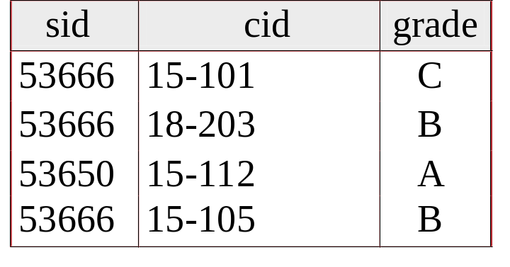
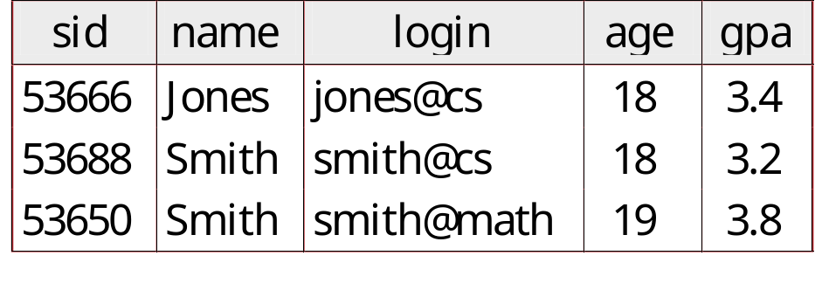
Keys
Keys help associate tuples in different relations
Keys are one form of integrity constraints (ICs)
Enrolled
Students
FOREIGN Key
PRIMARY Key

Slide 24
Superkey, Primary and Candidate Keys
A set of fields is a superkey if:
  No two distinct tuples can have same values in all key fields
A set of fields is a primary key for a relation if:
  It is a minimal superkey
  It is a unique identifier of the relations
What if there is more than one key for a relation?
  One of the keys is chosen (by DBA) to be the primary key
  Other keys are called candidate keys
Examples:
  sid is a key for Students (what about name?)
  The set {sid, name} is a superkey (or a set of fields that contains a key)
Notes:
Can we deem the set of all fields in an instance as a superkey?
Yes, since a relation is guaranteed to have a key, the set of all fields is always a superkey.
{login, age} could be a candidate key as well, but it is not minimal.

Slide 25
Primary and Candidate Keys in SQL
Many candidate keys (specified using UNIQUE) can be designated and one is chosen as a primary key
Keys must be used carefully!
“For a given student and course, there is a single grade”
CREATE TABLE Enrolled
(sid CHAR(20)
cid CHAR(20),
grade CHAR(2),
PRIMARY KEY (sid,cid))
CREATE TABLE Enrolled
(sid CHAR(20)
cid CHAR(20),
grade CHAR(2),
PRIMARY KEY (sid),
UNIQUE (cid, grade))
vs.
Q: What does this mean?

Slide 26
Primary and Candidate Keys in SQL
Many candidate keys (specified using UNIQUE) can be designated and one is chosen as a primary key
Keys must be used carefully!
“For a given student and course, there is a single grade”
CREATE TABLE Enrolled
(sid CHAR(20)
cid CHAR(20),
grade CHAR(2),
PRIMARY KEY (sid,cid))
CREATE TABLE Enrolled
(sid CHAR(20)
cid CHAR(20),
grade CHAR(2),
PRIMARY KEY (sid),
UNIQUE (cid, grade))
vs.
“A student can take only one course, and no two students in a course receive the same grade”

Slide 27
Foreign Keys and Referential Integrity
A foreign key is a set of fields referring to a tuple in another relation
  It must correspond to the primary key of the other relation
  It acts like a `logical pointer’
If all foreign key constraints are enforced, referential integrity is said to be achieved
(i.e., no dangling references)

Slide 28
Foreign Keys in SQL
Example: Only existing students may enroll for courses
  sid is a foreign key referring to Students
  How can we write this in SQL?
Enrolled
Students
CREATE TABLE Enrolled
(sid CHAR(20),cid CHAR(20),grade CHAR(2),
PRIMARY KEY (sid,cid),
FOREIGN KEY (sid) REFERENCES Students )

Slide 29
Enforcing Referential Integrity
What should be done if an “Enrolled” tuple with a non-existent student id is inserted? (Reject it!)
What should be done if a “Students” tuple is deleted?
  Disallow its deletion
  Delete all Enrolled tuples that refer to it
  Set sid in Enrolled tuples that refer to it to a default sid
  Set sid in Enrolled tuples that refer to it to a special value null, denoting `unknown’ or `inapplicable’
What if a “Students” tuple is updated?
  We can extend the Students relation with a column called “partner” and declare this column to be a foreign key referring to Students.
  If a students does not have a partner, we can set “partner” to null (this is allowed, denoting ‘unknown’ or ‘inapplicable’- i.e., we do not know the partner yet, or there is no partner)
Notes:
13

Slide 30
Where do Integrity Constraints Come From?
ICs are based upon the semantics of the real-world enterprise that is being described in the database relations
We can check a database instance to see if an IC is violated, but we can NEVER infer that an IC is true by looking at an instance
  An IC is a statement about all possible instances!
  From the “Students” relation, we know name is not a key, but the assertion that sid is a key is given to us
Key and foreign key are the most common ICs; more general ICs are supported too

Slide 31
Views
A view is a table whose rows are not explicitly stored but computed as needed
CREATE VIEW YoungActiveStudents (name, grade)
AS SELECT S.name, E.grade
FROM Students S, Enrolled E
WHERE S.sid = E.sid and S.age<21
Views can be queried
  Querying YoungActiveStudents would necessitate computing it first then applying the query on the result as being like any other relation
Views can be dropped using the DROP VIEW command
  How to handle DROP TABLE if there’s a view on the table?
    DROP TABLE command has options to let the user specify this
Notes:
18

Slide 32
Views and Security
Views can be used to present necessary information, while hiding details in underlying relation(s)
  If the schema of an old relation is changed, a view can be defined to represent the old schema
    This allows applications to transparently assume the old schema
  Views can be defined to give a group of users access to just the information they are allowed to see
    E.g., we can define a view that allows students to see other students’ names and ages, but not GPAs (also students can be prevented from accessing the underlying “Students” relation)
Logical Data Independence!
Security!
Notes:
22

Slide 33
Outline
The Relational Model: Introduction
The Relational Model: Basic SQL
Translating ER Diagrams to Tables via SQL

Slide 34
Strong Entity Sets to Tables
Employees
name
ssn
lot
ssn name lot
e1
xx yy zz
Employees
e2
Data
(entities)
:
CREATE TABLE Employees
(ssn CHAR(11),
name CHAR(20),
lot INTEGER,
PRIMARY KEY (ssn))

Slide 35
M-to-N Relationship Sets to Tables
since
name
dname
ssn
lot
did
budget
Employees
Works_In
Departments
CREATE TABLE Works_In(
ssn CHAR(11),
did INTEGER,
since DATE,
PRIMARY KEY (ssn, did),
FOREIGN KEY (ssn)
REFERENCES Employees,
FOREIGN KEY (did)
REFERENCES Departments)

Slide 36
1-to-M Relationship Sets to Tables
since
name
dname
ssn
lot
did
budget
Employees
Manages
Departments
CREATE TABLE Manages(
ssn CHAR(11),
did INTEGER,
since DATE,
PRIMARY KEY (did),
FOREIGN KEY (ssn) REFERENCES Employees,
FOREIGN KEY (did) REFERENCES Departments)
CREATE TABLE Departments(
did INTEGER,
dname CHAR(20),
budget REAL,
PRIMARY KEY (did),)
Approach 1: Create separate tables for Manages and Departments

Slide 37
1-to-M Relationship Sets to Tables
since
name
dname
ssn
lot
did
budget
Employees
Manages
Departments
CREATE TABLE Dept_Mgr(
ssn CHAR(11),
did INTEGER,
since DATE,
dname CHAR(20),
budget REAL,
PRIMARY KEY (did),
FOREIGN KEY (ssn)
REFERENCES Employees)
Can ssn take a
null value?
Approach 2: Create a table for only the Departments entity set
(i.e., take advantage of the key constraint)

Slide 38
One-Table vs. Two-Table Approaches
The one-table approach:
  (+) Eliminates the need for a separate table for the involved relationship set (e.g., Manages)
  (+) Queries can be answered without combining information from two relations
  (-) Space could be wasted!
    What if several departments have no managers?
The two-table approach:
  The opposite of the one-table approach!

Slide 39
Translating Relationship Sets with Participation Constraints
What does the following ER diagram entail (with respect to Departments and Managers)?
since
name
name
dname
dname
ssn
did
did
budget
lot
budget
Employees
Manages
Departments
Works_In
since
    Every did value in Departments table must appear in a row of the Manages table- if defined- (with a non-null ssn value!)

Slide 40
Translating Relationship Sets with Participation Constraints
Here is how to create the “Dept_Mgr” table using the one-table approach:
CREATE TABLE Dept_Mgr(
did INTEGER,
dname CHAR(20),
budget REAL,
ssn CHAR(11) NOT NULL,
since DATE,
PRIMARY KEY (did),
FOREIGN KEY (ssn) REFERENCES Employees,)
Enforces a column to NOT accept NULL values

Slide 41
Translating Weak Entity Sets
A weak entity set always:
  Participates in a one-to-many binary relationship
  Has a key constraint and total participation
Which approach is ideal for that?
  The one-table approach
name
ssn
lot
cost
dname
age
Employees
Policy
Dependents

Slide 42
Translating Weak Entity Sets
name
ssn
lot
cost
dname
age
Employees
Policy
Dependents
Here is how to create “Dep_Policy” using the
one-table approach
CREATE TABLE Dep_Policy (
dname CHAR(20),
age INTEGER,
cost REAL,
ssn CHAR(11) NOT NULL,
PRIMARY KEY (dname, ssn),
FOREIGN KEY (ssn) REFERENCES Employees,
ON DELETE CASCADE)
To specify whether you want rows deleted in a child table when corresponding rows are deleted in the parent table.

Slide 43
Translating Aggregations
Consider the following example:
name
ssn
lot
Employees
Monitors
until
started_on
since
dname
pid
pbudget
did
budget
Projects
Sponsors
Departments

Slide 44
Translating Aggregations
Standard approach:
  The Employees, Projects and Departments
  entity sets and the Sponsors relationship sets
  are translated as described previously
  For the Monitors relationship,
  we create a relation with
  the following attributes:
    The key attribute of Employees (i.e., ssn)
    The key attributes of Sponsors (i.e., did, pid)
    The descriptive attributes of Monitors (i.e., until)
ssn
name
lot
Employees
Monitors
until
started_on
since
dname
pid
pbudget
did
budget
Projects
Sponsors
Departments

Slide 45
The Relational Model: A Summary
A tabular representation of data
Simple and intuitive, currently one of the most widely used
Integrity constraints can be specified (by the DBA) based on application semantics (DBMS checks for violations)
  Two important ICs: primary and foreign keys
  Also: not null, unique
  In addition, we always have domain constraints
Mapping from ER to Relational is (fairly) straightforward!

Slide 46
ER to Tables: A Summary
Strong entities:
  Key -> primary key
(Binary) relationships:
  Get keys from all participating entities:
    1:1 -> either key can be the primary key
    1:N -> the key of the ‘N’ part will be the primary key
    M:N -> both keys will be the primary key
Weak entities:
  Strong key + partial key -> primary key
  Strong key: ON DELETE CASCADE
Total/Partial participation:
  NOT NULL
Aggregation: like relationships

Slide 47
Thank you!!!

